Slide 1
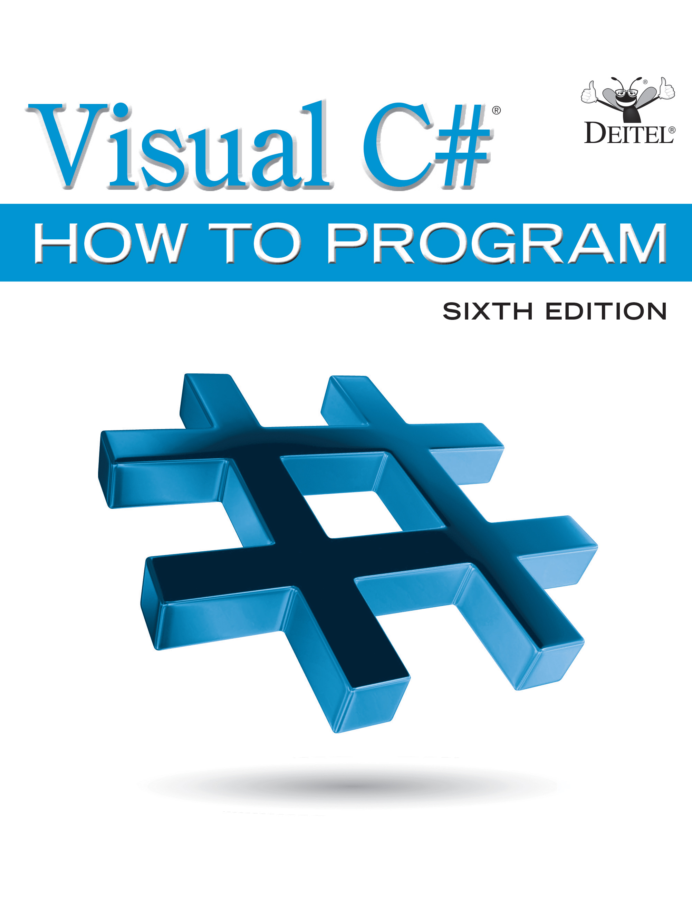
Visual C sharp ® How to Program
Sixth Edition
Chapter 15
Graphical User Interfaces with Windows Forms: Part 2
Copyright © 2017 Pearson Education, Inc. All Rights Reserved
Notes:
If this PowerPoint presentation contains mathematical equations, you may need to check that your computer has the following installed:
1) MathType Plugin
2) Math Player (free versions available)
3) NVDA Reader (free versions available)

Slide 2
Learning Objectives
Create menus, tabbed windows and multiple document interface (M D I) programs.
Use the ListView and TreeView controls for displaying information.
Create hyperlinks using the LinkLabel control.
Display lists of information in ListBox, CheckedListBox and ComboBox controls.
Input dates with the MonthCalendar control.
Input date and time data with the DateTimePicker control.
Create custom controls.
Use visual inheritance to build upon an existing G U I.

Slide 3
Outline (1 of 2)
15.1 Introduction
15.2 Menus
15.3 MonthCalendar Control
15.4 DateTimePicker Control
15.5 LinkLabel Control
15.6 ListBox Control
15.7 CheckedListBox Control
15.8 ComboBox Control
15.9 TreeView Control

Slide 4
Outline (2 of 2)
15.10 ListView Control
15.11 TabControl Control
15.12 Multiple Document Interface (M D I) Windows
15.13 Visual Inheritance
15.14 User-Defined Controls
15.15 Wrap-Up

Slide 5
15.1 Introduction
Visual Studio provides a large set of G U I components.
Visual Studio also enables you to design custom controls and add them to the ToolBox.

Slide 6
15.2 Menus (1 of 8)
Menus provide groups of related commands for Windows Forms apps (Figure 15.1).
Menus organize commands without “cluttering” the G U I.

Slide 7
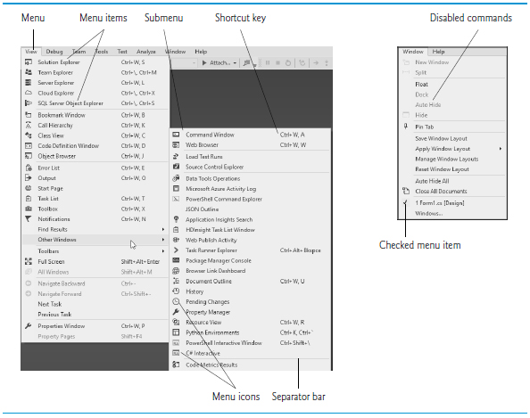
Figure 15.1 Menus, Submenus and Menu Items

Slide 8
15.2 Menus (2 of 8)
To create a menu, open the Toolbox and drag a MenuStrip control onto the Form.
To add menu items to the menu, click the Type Here TextBox (Figure 15.2) and type the menu item’s name.

Slide 9
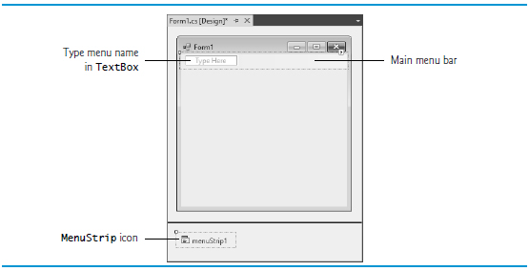
Figure 15.2 Editing Menus in Visual Studio

Slide 10
15.2 Menus (3 of 8)
After you press the Enter key, the menu item is added.
More Type Here TextBoxes allow you to add more items (Figure 15.3).

Slide 11
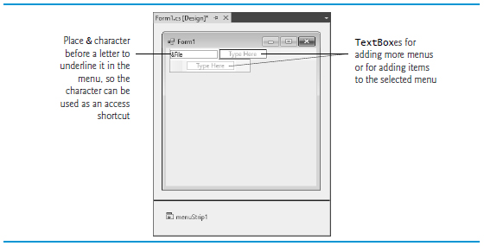
Figure 15.3 Adding ToolStripMenuItems to a MenuStrip

Slide 12
15.2 Menus (4 of 8)
Menus can have Alt key shortcuts which are accessed by pressing Alt and the underlined letter.
To make the File menu item have a key shortcut, type &File.
The letter F is underlined to indicate that it’s a shortcut.

Slide 13
15.2 Menus (5 of 8)
Menu items can have shortcut keys as well (Ctrl, Shift, Alt, F1, F2, letter keys, and so on).
To add other shortcut keys, set the ShortcutKeys property (Figure 15.4).

Slide 14
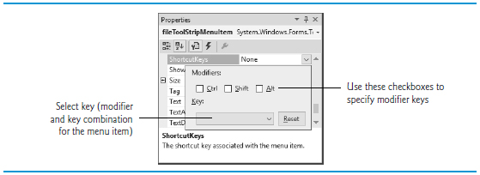
Figure 15.4 Setting a Menu Item’s Shortcut Keys

Slide 15
15.2 Menus (6 of 8)
You can remove a menu item by selecting it with the mouse and pressing the Delete key.
Menu items can be grouped by separator bars, which are inserted by right clicking and selecting Insert → Separator or by typing “-” for the text of a menu item.

Slide 16
Look-and-Feel Observation 15.1
Buttons can have access shortcuts. Place the & symbol immediately before the desired character in the Button’s text. To press the button by using its access key in the running app, the user presses Alt and the underlined character. If the underline is not visible when the app runs, press the Alt key to display the underlines.

Slide 17
15.2 Menus (7 of 8)
Visual Studio allows you to add TextBoxes and ComboBoxes as menu items.
Before you enter text for a menu item, you are provided with a drop-down list.
Clicking the down arrow allows you to select the type of item to add (Figure 15.5).

Slide 18
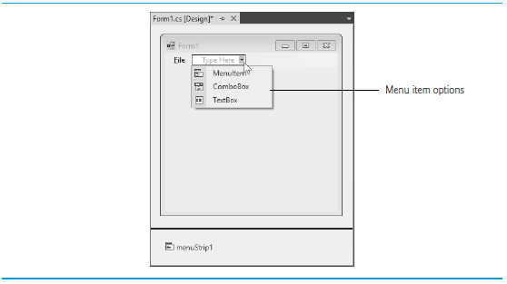
Figure 15.5 Menu-Item Options

Slide 19
Look-and-Feel Observation 15.2
It’s a convention to place an ellipsis (…) after the name of a menu item (example, Save As…) that requires the user to provide more information—typically through a dialog. A menu item that produces an immediate action without prompting the user for more information (example Save) should not have an ellipsis following its name.

Slide 20
Figure 15.6 MenuStrip and ToolStripMenuItem Properties and an Event (1 of 4)
MenuStrip Properties
MenuStrip and ToolStripMenuItem properties and an event | Description
Right To Left | Causes text to display from right to left. This is useful for languages that are read from right to left.

Slide 21
Figure 15.6 MenuStrip and ToolStripMenuItem Properties and an Event (2 of 4)
ToolStripMenuItem properties
MenuStrip and ToolStripMenuItem properties and an event | Description
Checked | Indicates whether a menu item is checked. The default value is false, meaning that the menu item is unchecked.
CheckOnClick | Indicates that a menu item should appear checked or unchecked as it is clicked.
ShortcutKey- DisplayString | Specifies text that should appear beside a menu item for a shortcut key. If left blank, the key names are displayed. Otherwise, the text in this property is displayed for the shortcut key.
ShortcutKeys | Specifies the shortcut key for the menu item (example, <Ctrl>-F9 is equivalent to clicking a specific item).

Slide 22
Figure 15.6 MenuStrip and ToolStripMenuItem Properties and an Event (3 of 4)
MenuStrip and ToolStripMenuItem properties and an event | Description
ShowShortcutKeys | Indicates whether a shortcut key is shown beside menu item text. The default is true, which displays the shortcut key.
Text | Specifies the menu item’s text. To create an Alt access shortcut, precede a character with & (example, &File to specify a menu named File with the letter F underlined).

Slide 23
Figure 15.6 MenuStrip and ToolStripMenuItem Properties and an Event (4 of 4)
Common ToolStripMenuItem Event
MenuStrip and ToolStripMenuItem properties and an event | Description
Click | Generated when an item is clicked or a shortcut key is used. This is the default event when the menu is double clicked in the designer.

Slide 24
15.2 Menus (8 of 8)
Class MenuTestForm (Figure 15.7) creates a simple menu on a Form.

Slide 25
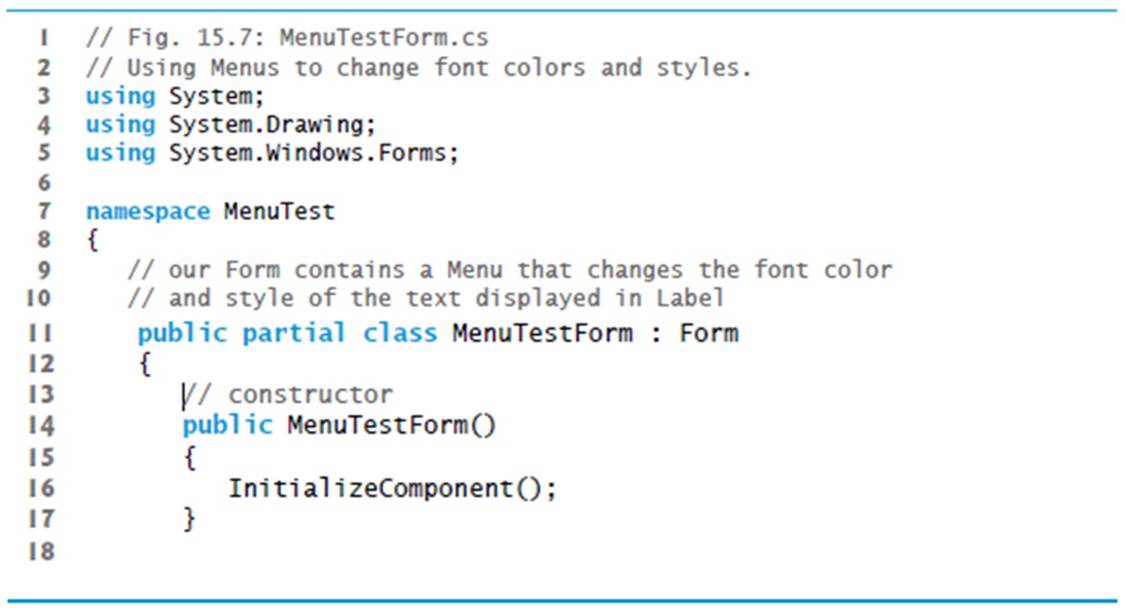
Figure 15.7 Using Menus for Changing text Font and Color (1 of 11)

Slide 26
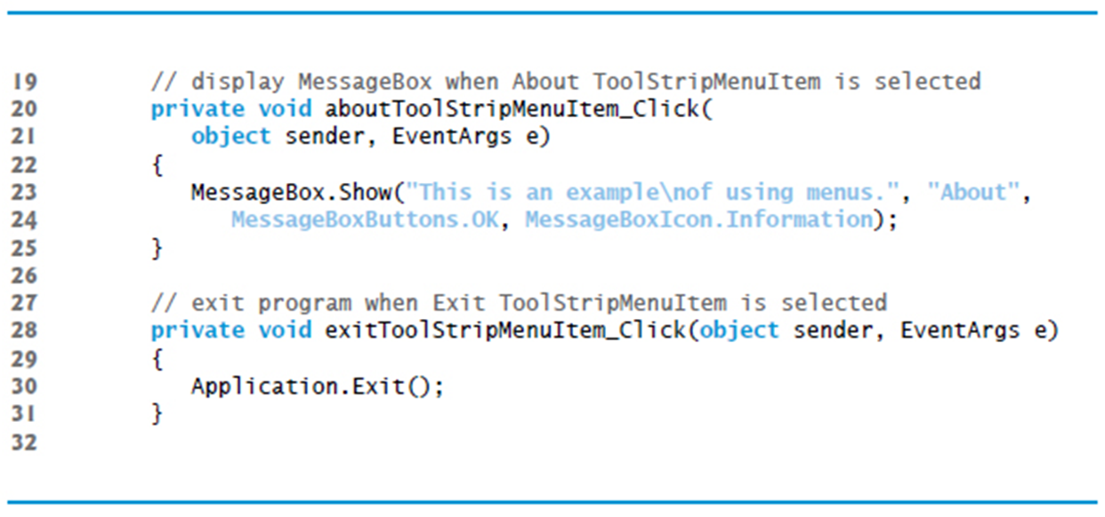
Figure 15.7 Using Menus for Changing text Font and Color (2 of 11)

Slide 27
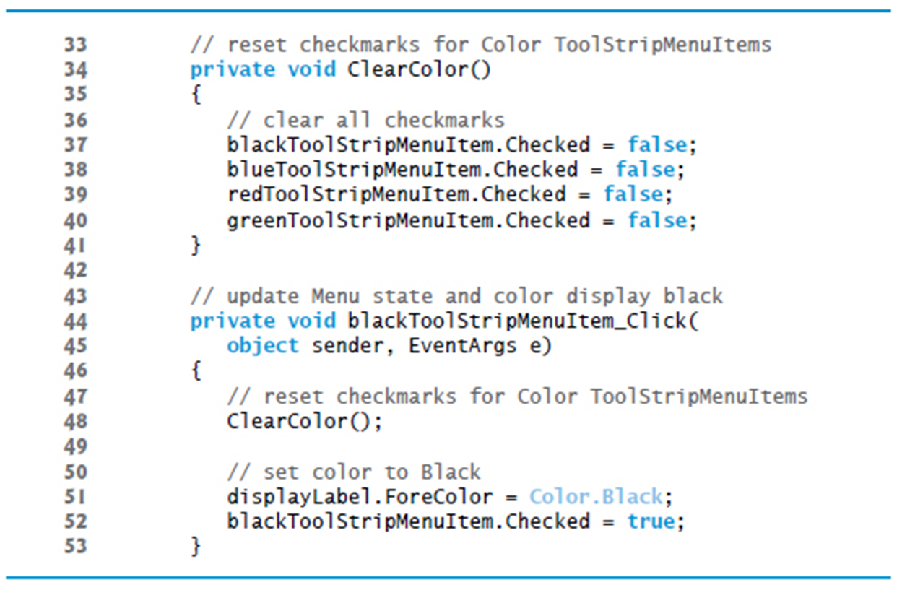
Figure 15.7 Using Menus for Changing text Font and Color (3 of 11)

Slide 28
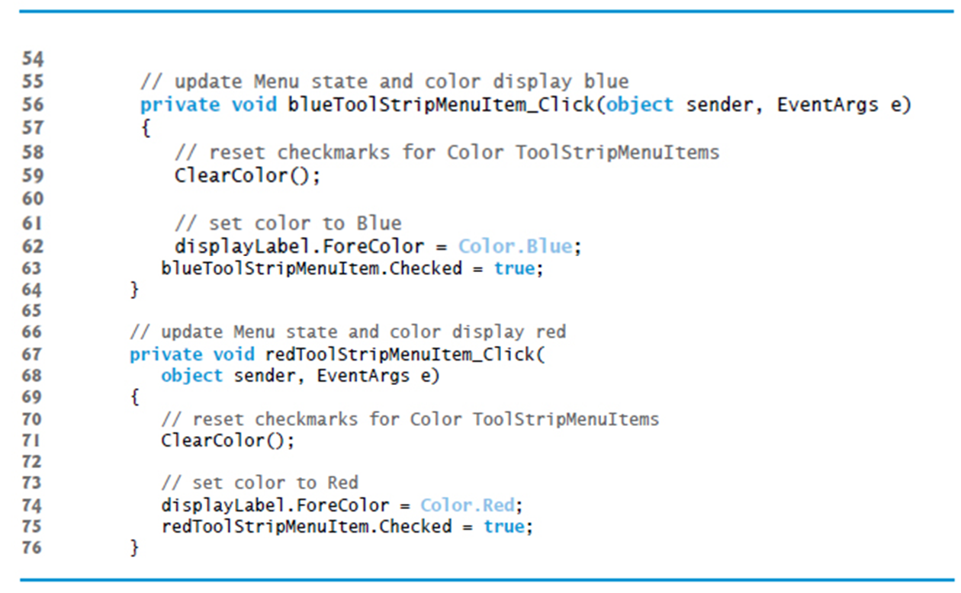
Figure 15.7 Using Menus for Changing text Font and Color (4 of 11)

Slide 29
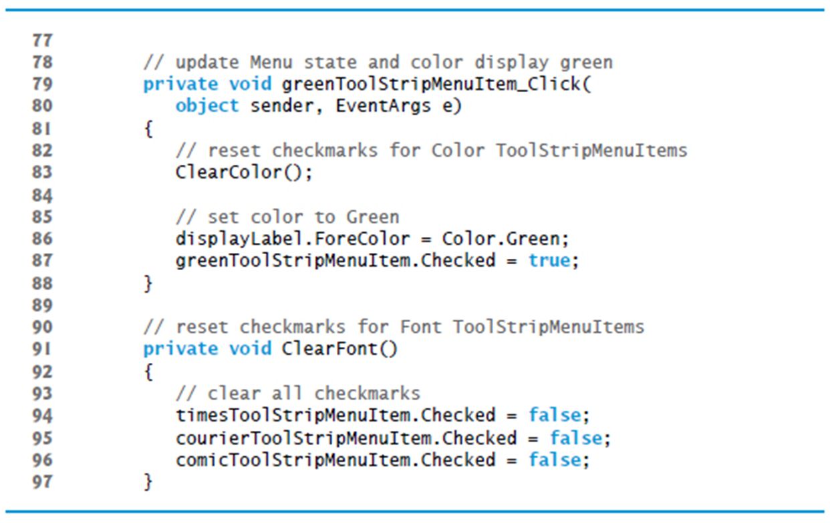
Figure 15.7 Using Menus for Changing text Font and Color (5 of 11)

Slide 30
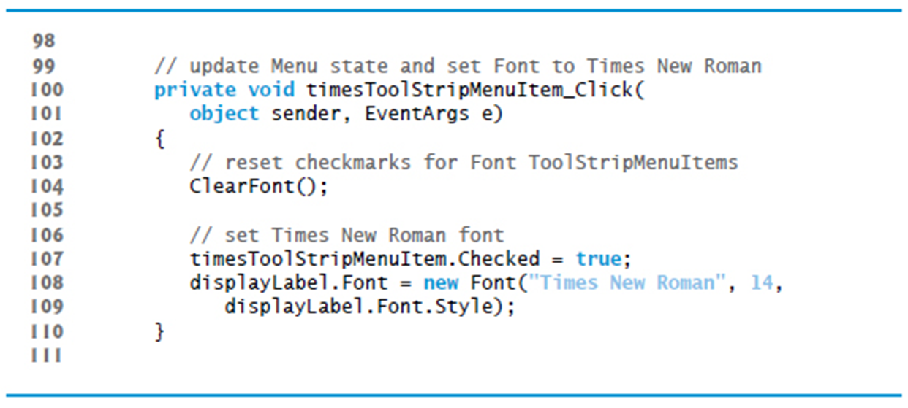
Figure 15.7 Using Menus for Changing text Font and Color (6 of 11)

Slide 31
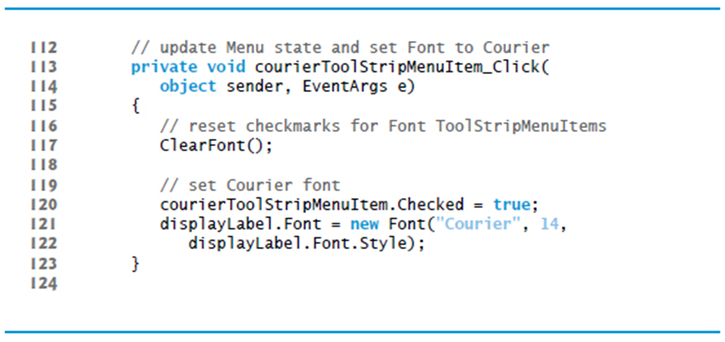
Figure 15.7 Using Menus for Changing text Font and Color (7 of 11)

Slide 32
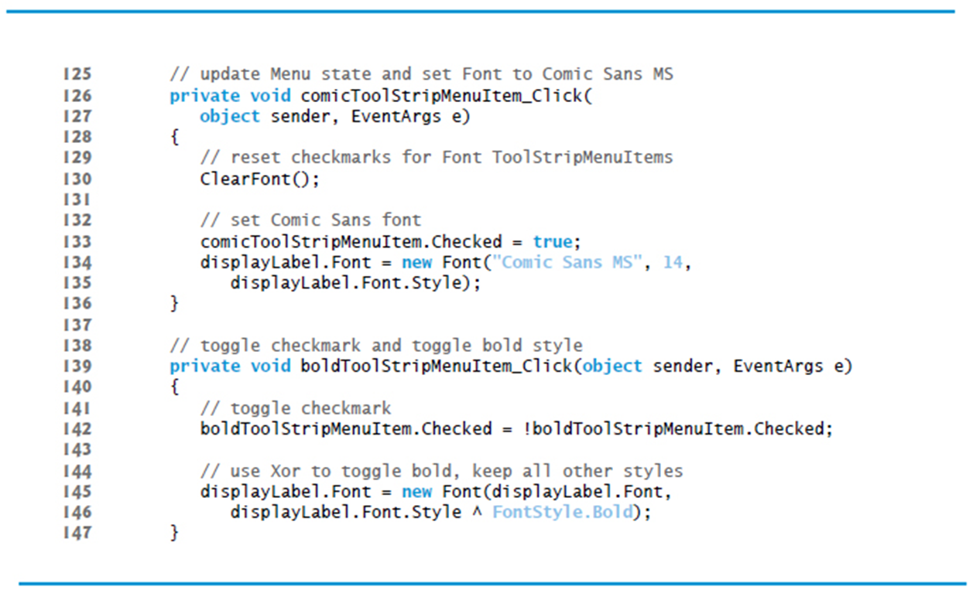
Figure 15.7 Using Menus for Changing text Font and Color (8 of 11)

Slide 33
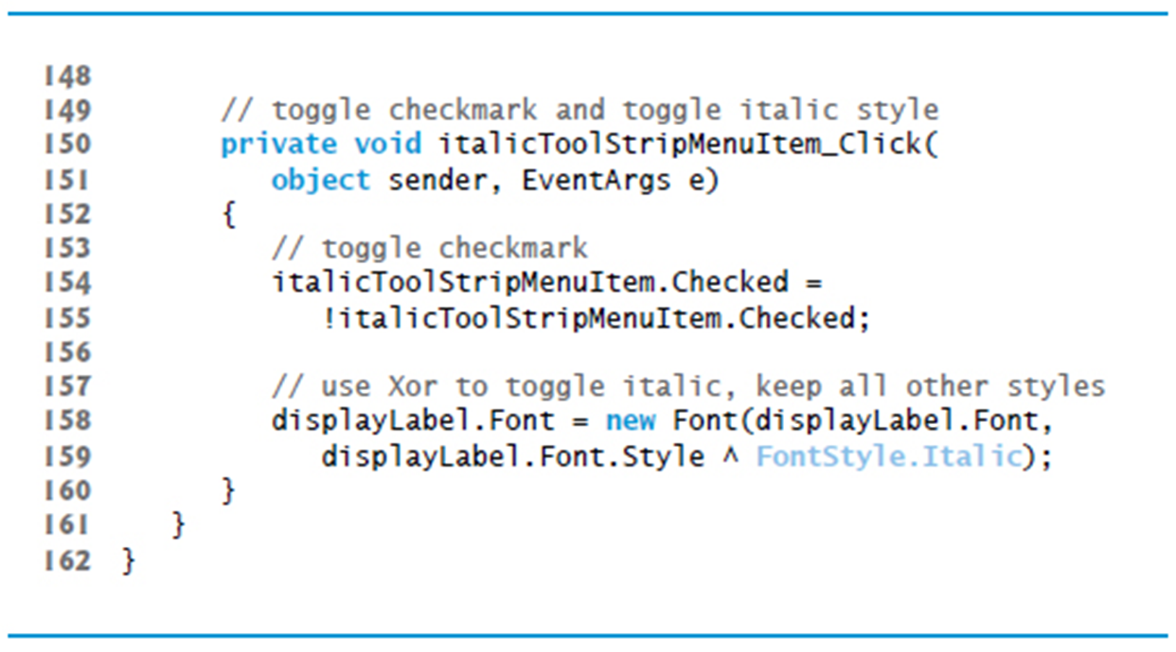
Figure 15.7 Using Menus for Changing text Font and Color (9 of 11)

Slide 34
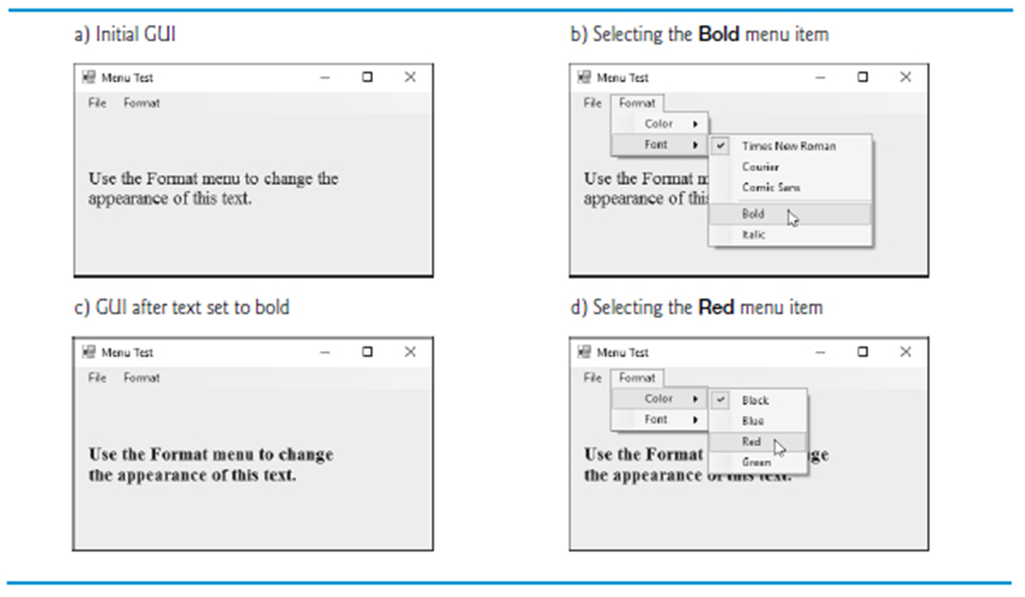
Figure 15.7 Using Menus for Changing text Font and Color (10 of 11)

Slide 35
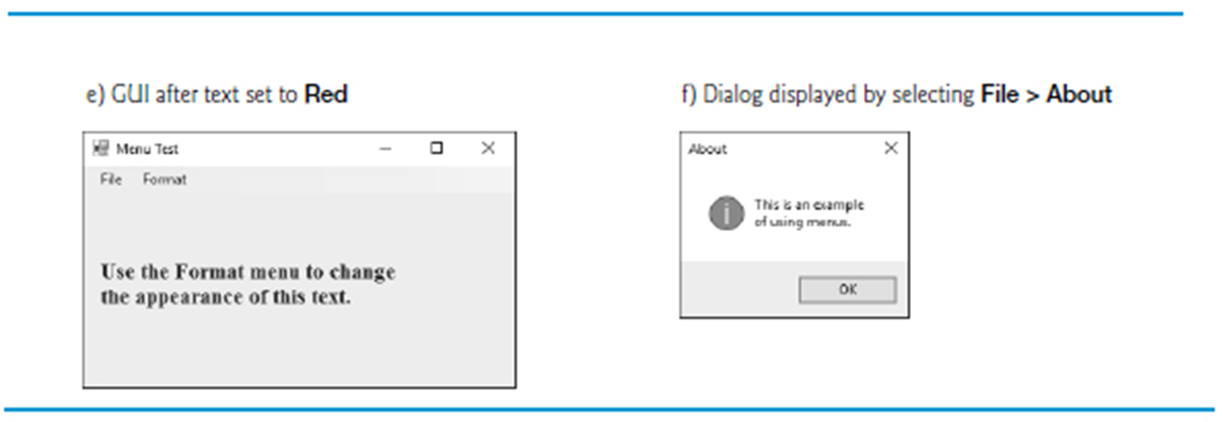
Figure 15.7 Using Menus for Changing text Font and Color (11 of 11)

Slide 36
Software Engineering Observation 15.1
The mutual exclusion of menu items is not enforced by the MenuStrip, even when the Checked property is true. You must program this behavior.

Slide 37
15.3 MonthCalendar Control
The MonthCalendar control (Figure 15.8) displays a monthly calendar on the Form.
Multiple dates can be selected by clicking dates on the calendar while holding down the Shift key.

Slide 38
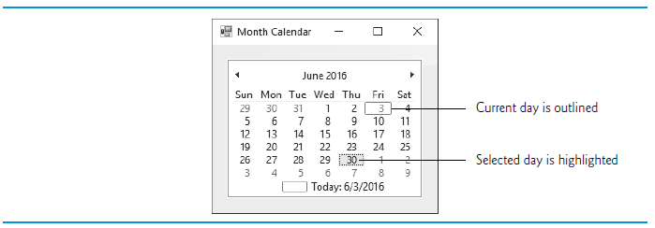
Figure 15.8 MonthCalendar Control

Slide 39
Figure 15.9 MonthCalendar Properties and an Event (1 of 2)
MonthCalendar Properties
MonthCalendar properties and an event | Description
FirstDayOfWeek | Sets which day of the week is the first displayed for each week in the calendar.
MaxDate | The last date that can be selected.
MaxSelectionCount | The maximum number of dates that can be selected at once.
MinDate | The first date that can be selected.
MonthlyBoldedDates | An array of dates that will be displayed in bold in the calendar.
SelectionEnd | The last of the dates selected by the user.
SelectionRange | The dates selected by the user.
SelectionStart | The first of the dates selected by the user.

Slide 40
Figure 15.9 MonthCalendar Properties and an Event (2 of 2)
Common MonthCalendar Event
MonthCalendar properties and an event | Description
DateChanged | Generated when a date is selected in the calendar.

Slide 41
15.4 DateTimePicker Control (1 of 2)
The DateTimePicker control displays a calendar when a down arrow is selected.
The DateTimePicker can be used to retrieve date and time information from the user.

Slide 42
Figure 15.10 DateTimePicker Properties and an Event (1 of 2)
DateTimePicker Properties
DateTimePicker properties and an event | Description
CalendarForeColor | Sets the text color for the calendar.
CalendarMonthBackground | Sets the calendar’s background color.
CustomFormat | Sets the custom format string for the date and/or time displayed in the control.
Format | Sets the format of the date and/or time used for the date and/or time displayed in the control.
MaxDate | The maximum date and time that can be selected.
MinDate | The minimum date and time that can be selected.
ShowCheckBox | Indicates if a CheckBox should be displayed to the left of the selected date and time.

Slide 43
Figure 15.10 DateTimePicker Properties and an Event (2 of 2)
DateTimePicker properties and an event | Description
ShowUpDown | Indicates whether the control displays up and down Buttons. Helpful when the DateTimePicker is used to select a time—the Buttons can be used to increase or decrease hour, minute and second.
Value | The data selected by the user.
Common DateTimePicker Event
DateTimePicker properties and an event | Description
ValueChanged | Generated when the Value property changes, including when the user selects a new date or time.

Slide 44
15.4 DateTimePicker Control (2 of 2)
Figure 15.11 demonstrates using the DateTimePicker control to select an item’s drop-off time.
The DateTimePicker has its Format property set to Long.
In this app, the arrival date is always two days after drop-off, or three days if a Sunday is reached.

Slide 45
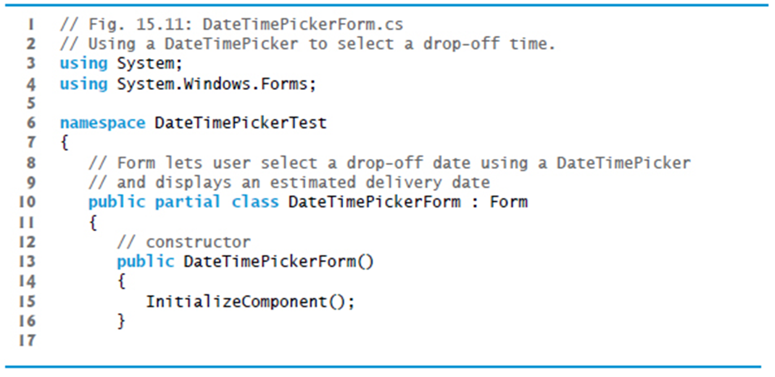
Figure 15.11 Using a DateTimePicker to Select a Drop-Off Time (1 of 5)

Slide 46
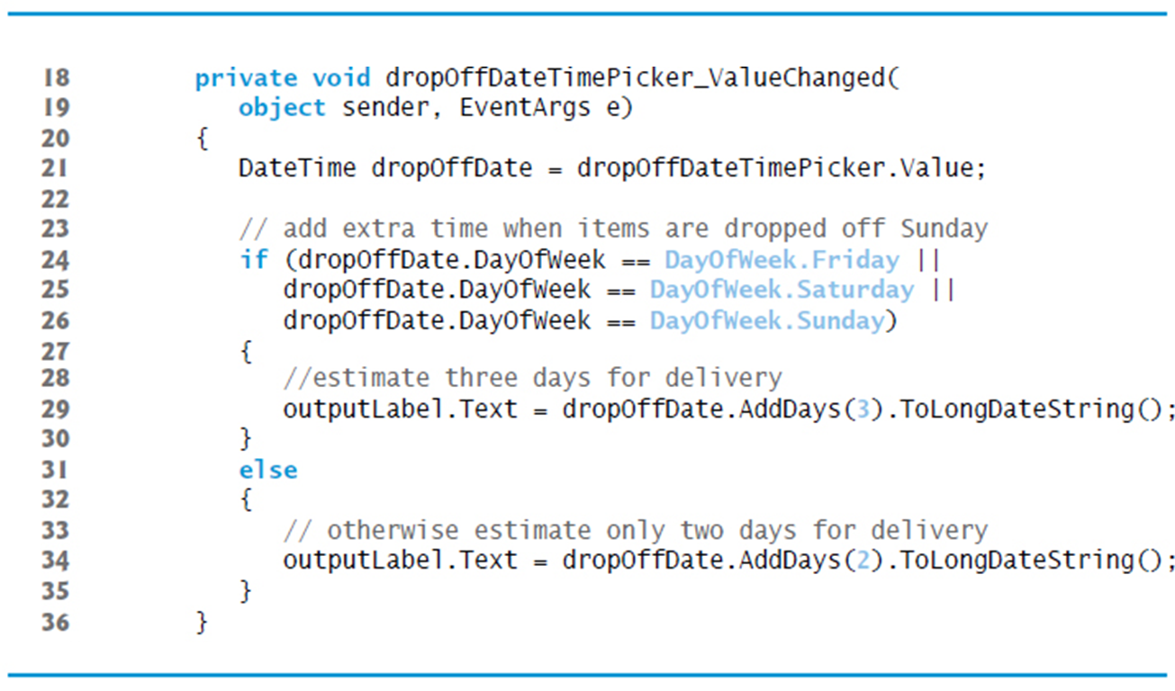
Figure 15.11 Using a DateTimePicker to Select a Drop-Off Time (2 of 5)

Slide 47
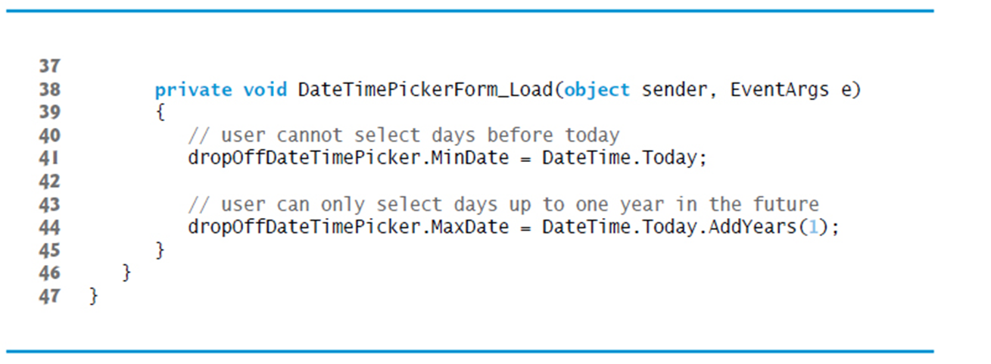
Figure 15.11 Using a DateTimePicker to Select a Drop-Off Time (3 of 5)

Slide 48
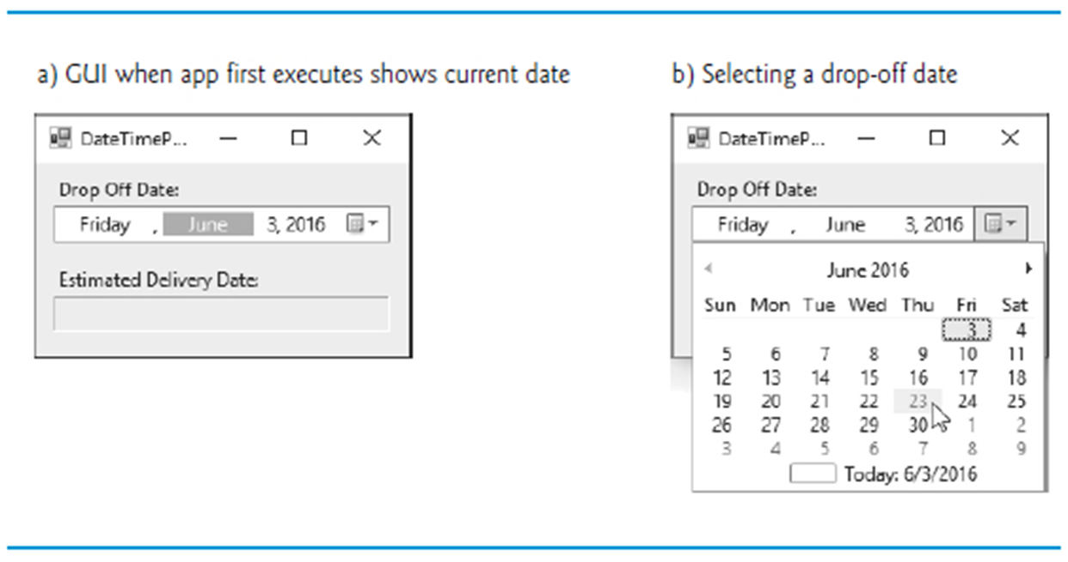
Figure 15.11 Using a DateTimePicker to Select a Drop-Off Time (4 of 5)

Slide 49
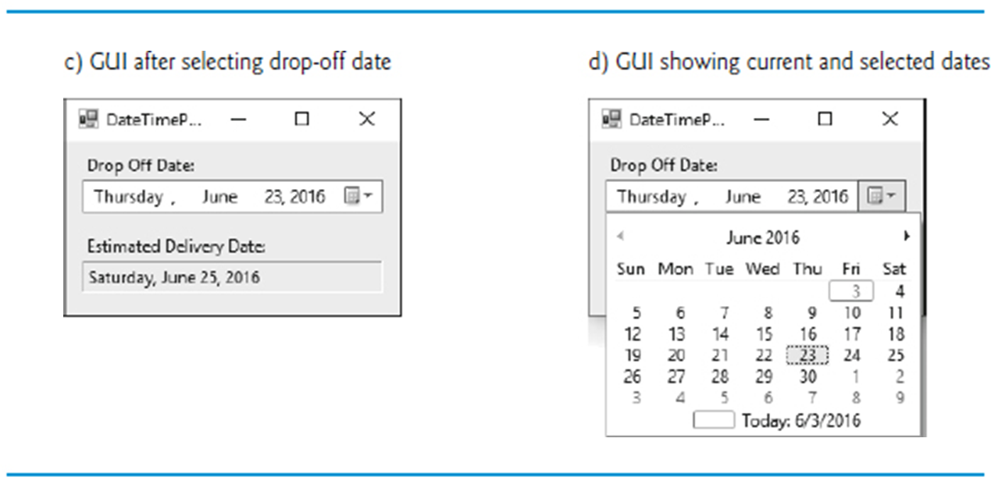
Figure 15.11 Using a DateTimePicker to Select a Drop-Off Time (5 of 5)

Slide 50
15.5 LinkLabel Control (1 of 3)
The LinkLabel control displays links to other resources, such as files or web pages (Figure 15.12).

Slide 51
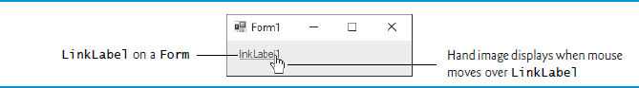
Figure 15.12 LinkLabel Control in Running Program

Slide 52
Look-and-Feel Observation 15.3
A LinkLabel is the preferred control for indicating that the user can click a link to jump to a resource such as a web page, though other controls can perform similar tasks.

Slide 53
15.5 LinkLabel Control (2 of 3)
When clicked, the LinkLabel generates a LinkClicked event (Figure 15.13).
Class LinkLabel is derived from class Label and therefore inherits all of class Label’s functionality.

Slide 54
Figure 15.13 LinkLabel Properties and an Event (1 of 2)
Common Properties
LinkLabel properties and an Event | Description
ActiveLinkColor | Specifies the color of the active link when the user is in the process of clicking the link. The default color (typically red) is set by the system.
LinkArea | Specifies which portion of text in the LinkLabel is part of the link.
LinkBehavior | Specifies the link’s behavior, such as how the link appears when the mouse is placed over it.
LinkColor | Specifies the original color of the link before it’s been visited. The default color (typically blue) is set by the system.

Slide 55
Figure 15.13 LinkLabel Properties and an Event (2 of 2)
LinkLabel properties and an Event | Description
LinkVisited | If true, the link appears as though it has been visited (its color is changed to that specified by property VisitedLinkColor). The default value is false.
Text | Specifies the control’s text.
UseMnemonic | If true, the & character in the Text property acts as a shortcut (similar to the Alt shortcut in menus).
VisitedLinkColor | Specifies the color of a visited link. The default color (typically purple) is set by the system.
Common Event (Event arguments LinkLabelLinkClickedEventArgs)
LinkLabel properties and an Event | Description
LinkClicked | Generated when the link is clicked. This is the default event when the control is double clicked in Design mode.

Slide 56
15.5 LinkLabel Control (3 of 3)
Class LinkLabelTestForm (Figure 15.14) uses three LinkLabels.
Method Start of class Process allows you to execute other programs, or load documents or web sites from an app.

Slide 57
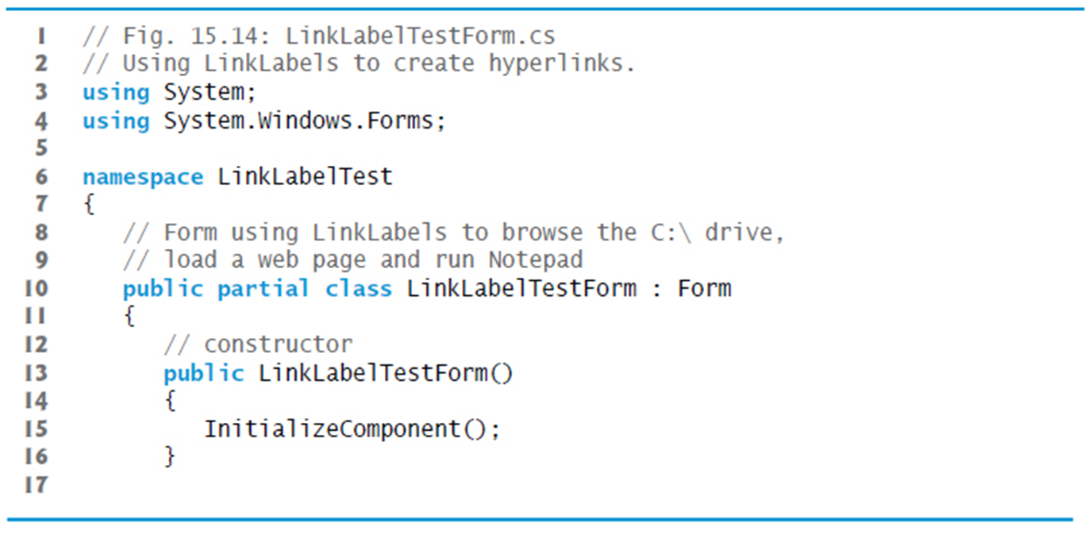
Figure 15.14 Using LinkLabels to Create Hyperlinks (1 of 5)

Slide 58
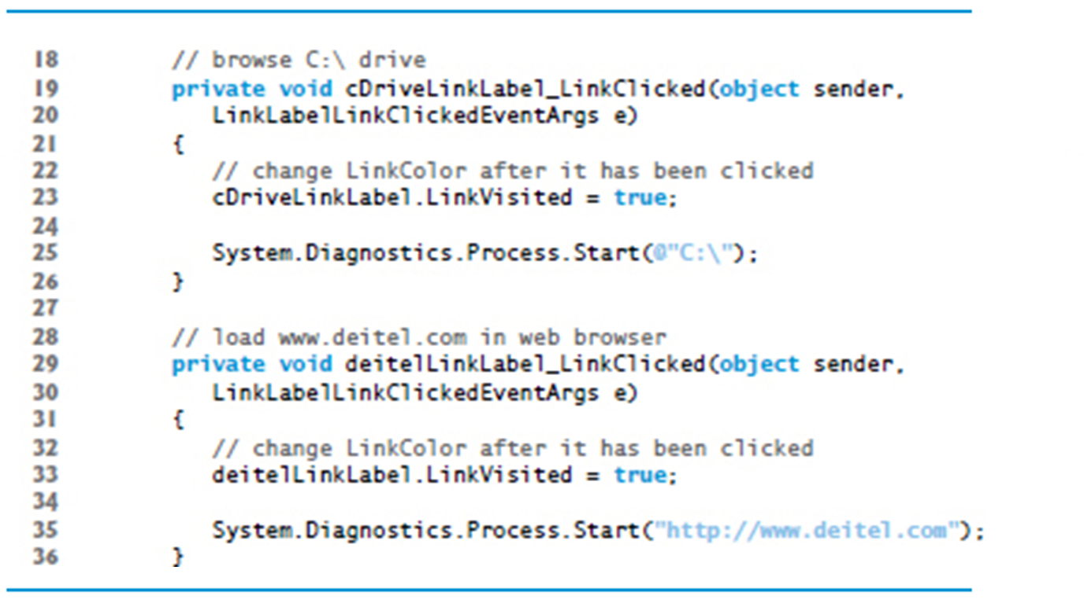
Figure 15.14 Using LinkLabels to Create Hyperlinks (2 of 5)

Slide 59
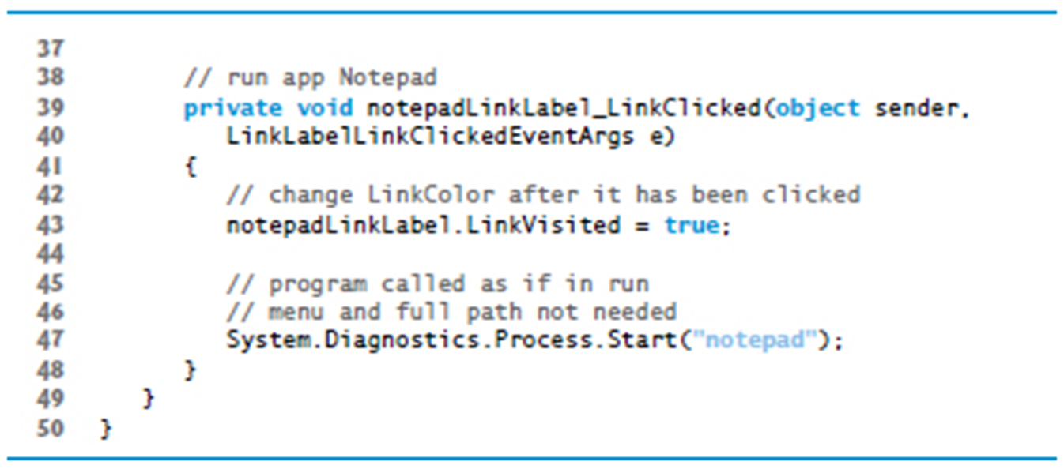
Figure 15.14 Using LinkLabels to Create Hyperlinks (3 of 5)

Slide 60
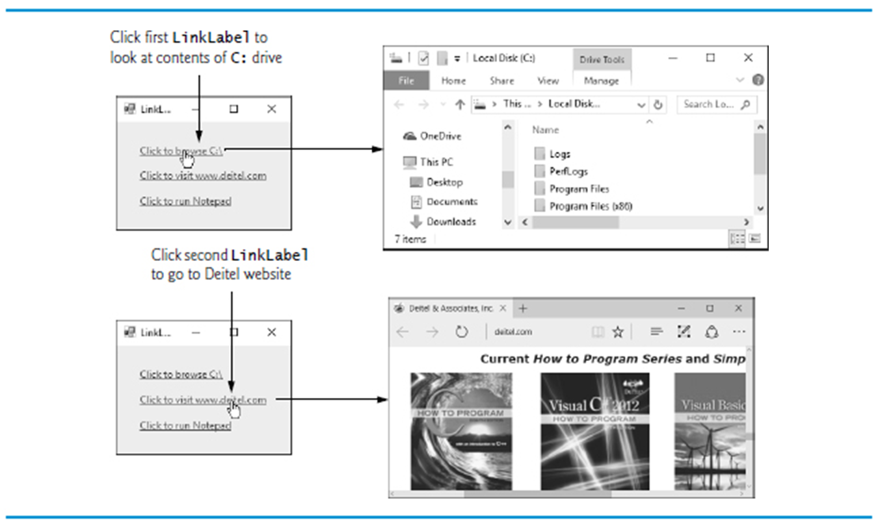
Figure 15.14 Using LinkLabels to Create Hyperlinks (4 of 5)

Slide 61
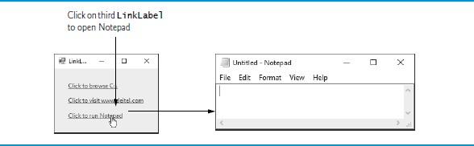
Figure 15.14 Using LinkLabels to Create Hyperlinks (5 of 5)

Slide 62
15.6 ListBox Control (1 of 3)
The ListBox control allows the user to view and select from multiple items in a list.
The CheckedListBox control extends a ListBox by including CheckBoxes next to each item in the list.
Figure 15.15 displays a ListBox and a CheckedListBox.

Slide 63
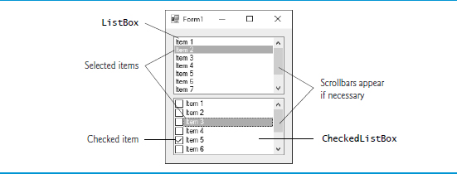
Figure 15.15 ListBox and CheckedListBox on a Form

Slide 64
Figure 15.16 ListBox Properties, Methods and an Event (1 of 3)
Common Properties
ListBox properties, methods and an event | Description
Items | The collection of items in the ListBox.
MultiColumn | Indicates whether the ListBox can display multiple columns. Multiple columns eliminate vertical scrollbars from the display.
SelectedIndex | Returns the index of the selected item. If no items have been selected, the property returns -1. If the user selects multiple items, this property returns only one of the selected indices. If multiple items are selected, use property SelectedIndices.
SelectedIndices | Returns a collection containing the indices for all selected items.
SelectedItem | Returns a reference to the selected item. If multiple items are selected, it can return any of the selected items.
SelectedItems | Returns a collection of the selected item(s).

Slide 65
Figure 15.16 ListBox Properties, Methods and an Event (2 of 3)
ListBox properties, methods and an event | Description
SelectionMode | Determines the number of items that can be selected and the means through which multiple items can be selected. Values are None, One (the default), MultiSimple (multiple selection allowed) or MultiExtended (multiple selection allowed using a combination of arrow keys or mouse clicks and Shift and Ctrl keys).
Sorted | Indicates whether items are sorted alphabetically. Setting this property’s value to true sorts the items. The default value is false.
Common Methods
ListBox properties, methods and an event | Description
ClearSelected | Deselects every item.
GetSelected | Returns true if the item at the specified index is selected.

Slide 66
Figure 15.16 ListBox Properties, Methods and an Event (3 of 3)
Common Event
ListBox properties, methods and an event | Description
SelectedIndexChanged | Generated when the selected index changes. This is the default event when the control is double clicked in the designer.

Slide 67

15.6 ListBox Control (2 of 3)
Adding Items to ListBoxes and CheckedListBoxes
To add items to a ListBox or to a CheckedListBox, we must add objects to its Items collection.
You can add items to ListBoxes and CheckedListBoxes visually by examining the Items property in the Properties window (Figure 15.17).

Slide 68
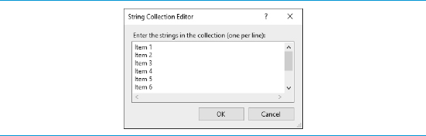
Figure 15.17 String Collection Editor

Slide 69
15.6 ListBox Control (3 of 3)
Figure 15.18 uses class ListBoxTestForm to add, remove and clear items from ListBox displayListBox.

Slide 70
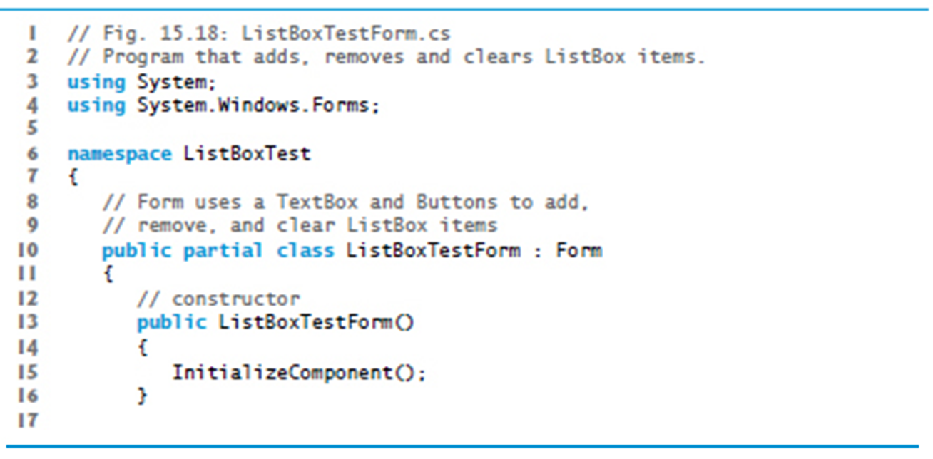
Figure 15.18 Program that Adds, Removes and Clears ListBox Items (1 of 5)

Slide 71
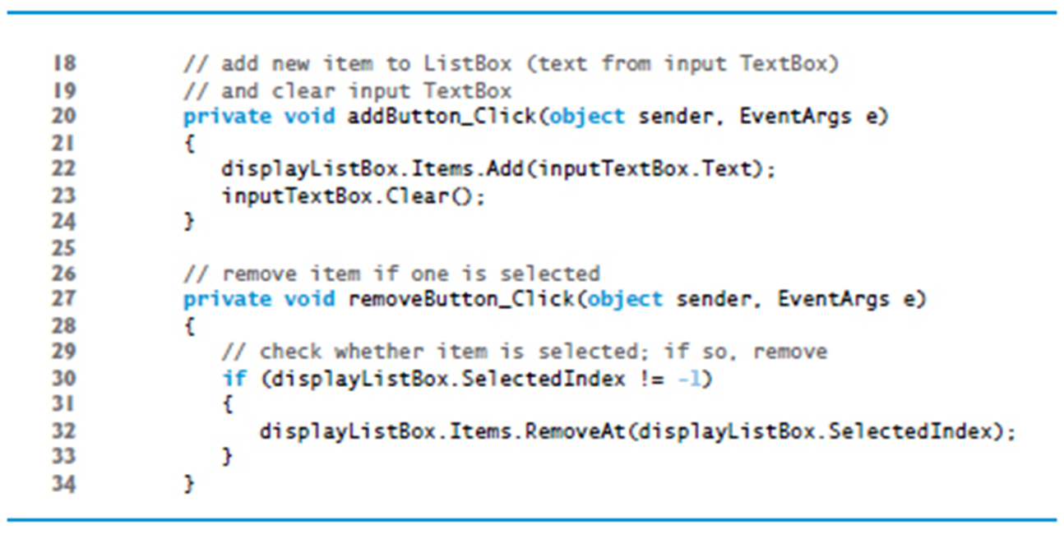
Figure 15.18 Program that Adds, Removes and Clears ListBox Items (2 of 5)

Slide 72
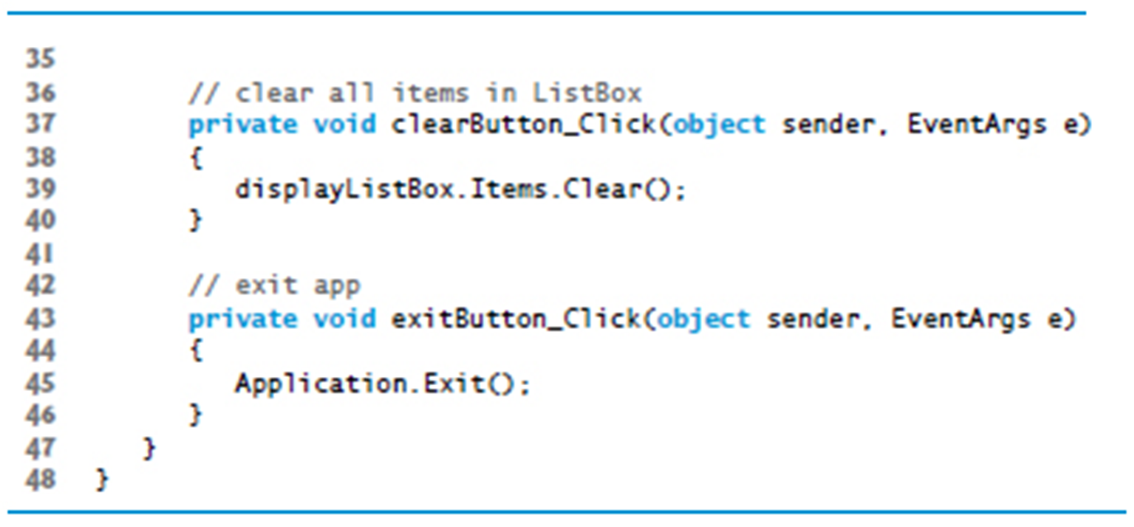
Figure 15.18 Program that Adds, Removes and Clears ListBox Items (3 of 5)

Slide 73
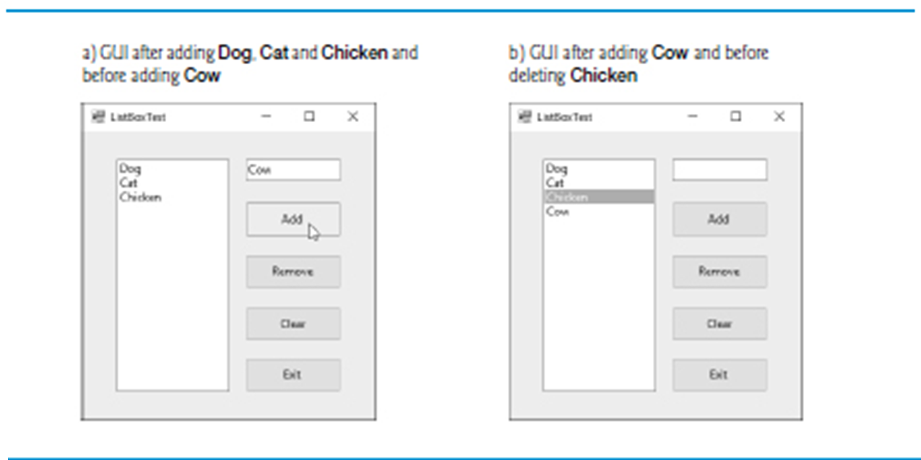
Figure 15.18 Program that Adds, Removes and Clears ListBox Items (4 of 5)

Slide 74
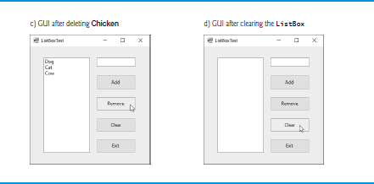
Figure 15.18 Program that Adds, Removes and Clears ListBox Items (5 of 5)

Slide 75
15.7 CheckedListBox Control (1 of 2)
The CheckedListBox control derives from ListBox and displays a CheckBox with each item (Figure 15.19 see slide 77).

Slide 76
Common Programming Error 15.1
The I D E displays an error message if you attempt to set the SelectionMode property to MultiSimple or MultiExtended in the Properties window of a CheckedListBox. If this value is set programmatically, a runtime error occurs.

Slide 77
Figure 15.19 CheckedListBox Properties, a Method and an Event (1 of 3)
Common Properties
(All the ListBox properties, methods and events are inherited by CheckedListBox.)
CheckedListBox properties, a method and an event | Description
CheckedItems | Accessible only at runtime. Returns the collection of items that are checked as a CheckedListBox. CheckedItemCollection. This is distinct from the selected item, which is highlighted (but not necessarily checked). There can be at most one selected item at any given time.
CheckedIndices | Accessible only at runtime. Returns indices for all checked items as a CheckedListBox.CheckedIndexCollection.
CheckOnClick | When true and the user clicks an item, the item is both selected and checked or unchecked. By default, this property is false, which means that the user must select an item, then click it again to check or uncheck it.

Slide 78
Figure 15.19 CheckedListBox Properties, a Method and an Event (2 of 3)
CheckedListBox properties, a method and an event | Description
SelectionMode | Determines whether items can be selected and checked. The possible values are One (the default; allows multiple checks to be placed) or None (does not allow any checks to be placed).
Common Method
CheckedListBox properties, a method and an event | Description
GetItemChecked | Takes an index and returns true if the corresponding item is checked.

Slide 79
Figure 15.19 CheckedListBox Properties, a Method and an Event (3 of 3)
Common Event (Event arguments ItemCheckEventArgs)
CheckedListBox properties, a method and an event | Description
ItemCheck | Generated when an item is checked or unchecked.
ItemCheckEventArgs Properties
CheckedListBox properties, a method and an event | Description
CurrentValue | Indicates whether the current item is checked or unchecked. Possible values are Checked, Unchecked and Indeterminate.
Index | Returns the zero-based index of the item that changed.
NewValue | Specifies the new state of the item.

Slide 80
15.7 CheckedListBox Control (2 of 2)
The CheckedListBox control derives from ListBox and displays a CheckBox with each item (Figure 15.20).

Slide 81
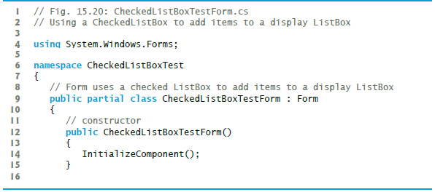
Figure 15.20 Using a CheckedListBox to Add Items to a Display ListBox (1 of 3)

Slide 82
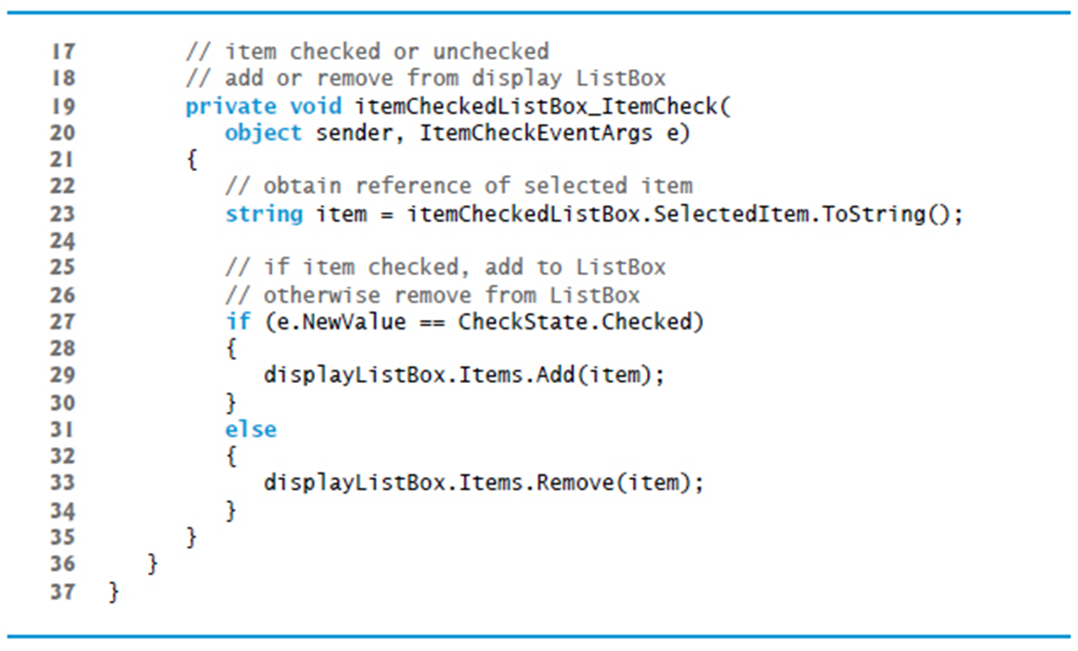
Figure 15.20 Using a CheckedListBox to Add Items to a Display ListBox (2 of 3)

Slide 83
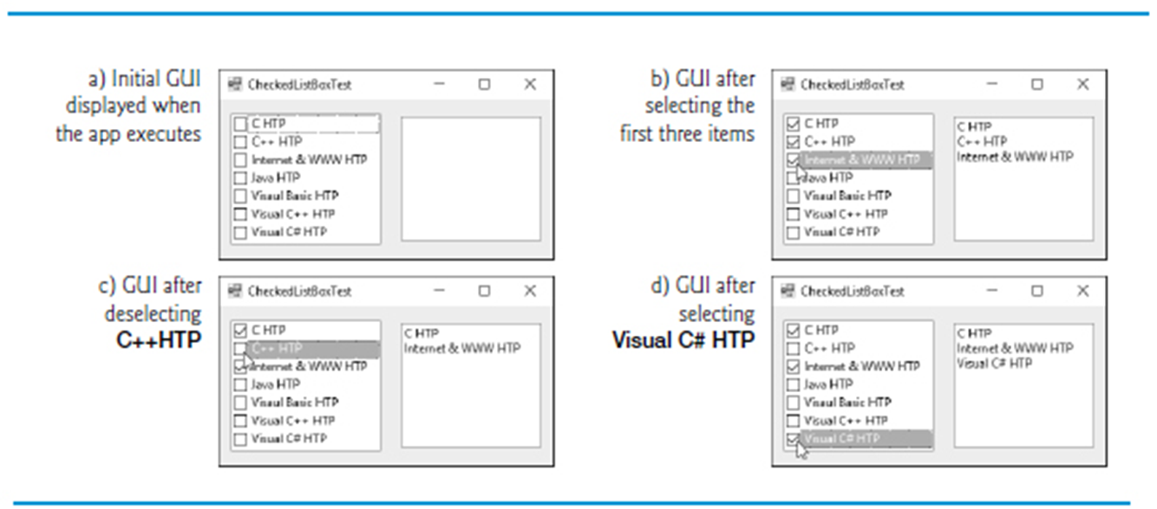
Figure 15.20 Using a CheckedListBox to Add Items to a Display ListBox (3 of 3)

Slide 84
15.8 ComboBox Control (1 of 2)
The ComboBox control combines TextBox features with a drop-down list.
Figure 15.21 shows a sample ComboBox in three different states.

Slide 85
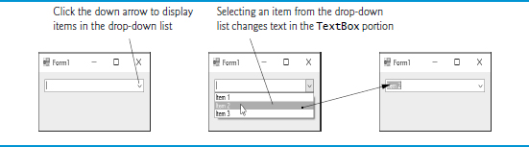
Figure 15.21 ComboBox Demonstration

Slide 86
Look-and-Feel Observation 15.4
Use a ComboBox to save space on a G U I. A disadvantage is that, unlike with a ListBox, the user cannot see available items without expanding the drop-down list.

Slide 87
Figure 15.22 ComboBox Properties and an Event (1 of 2)
Common Properties
ComboBox properties and an event | Description
DropDownStyle | Determines the type of ComboBox. Value Simple means that the text portion is editable and the list portion is always visible. Value DropDown (the default) means that the text portion is editable but the user must click an arrow button to see the list portion. Value DropDownList means that the text portion is not editable and the user must click the arrow button to see the list portion.
Items | The collection of items in the ComboBox control.
MaxDropDownItems | Specifies the maximum number of items (between 1 and 100) that the drop-down list can display. If the number of items exceeds the maximum number of items to display, a scrollbar appears.
SelectedIndex | Returns the index of the selected item, or -1 if none are selected.

Slide 88
Figure 15.22 ComboBox Properties and an Event (2 of 2)
ComboBox properties and an event | Description
SelectedItem | Returns a reference to the selected item.
Sorted | Indicates whether items are sorted alphabetically. Setting this property’s value to true sorts the items. The default is false.
Common Event
ComboBox properties and an event | Description
SelectedIndexChanged | Generated when the selected index changes (such as when a different item is selected). This is the default event when control is double clicked in the designer.

Slide 89
Look-and-Feel Observation 15.5
Make lists (such as ComboBoxes) editable only if the app is designed to accept user-submitted elements. Otherwise, the user might try to enter a custom item that’s improper for the purposes of your app.

Slide 90
15.8 ComboBox Control (2 of 2)
Class ComboBoxTestForm (Figure 15.23) allows users to select a shape to draw by using a ComboBox.
Set the ComboBox’s DropDownStyle to DropDownList to restrict users to preset options.

Slide 91
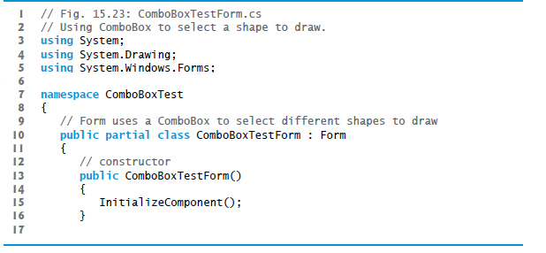
Figure 15.23 Using ComboBox to Select a Shape to Draw (1 of 5)

Slide 92
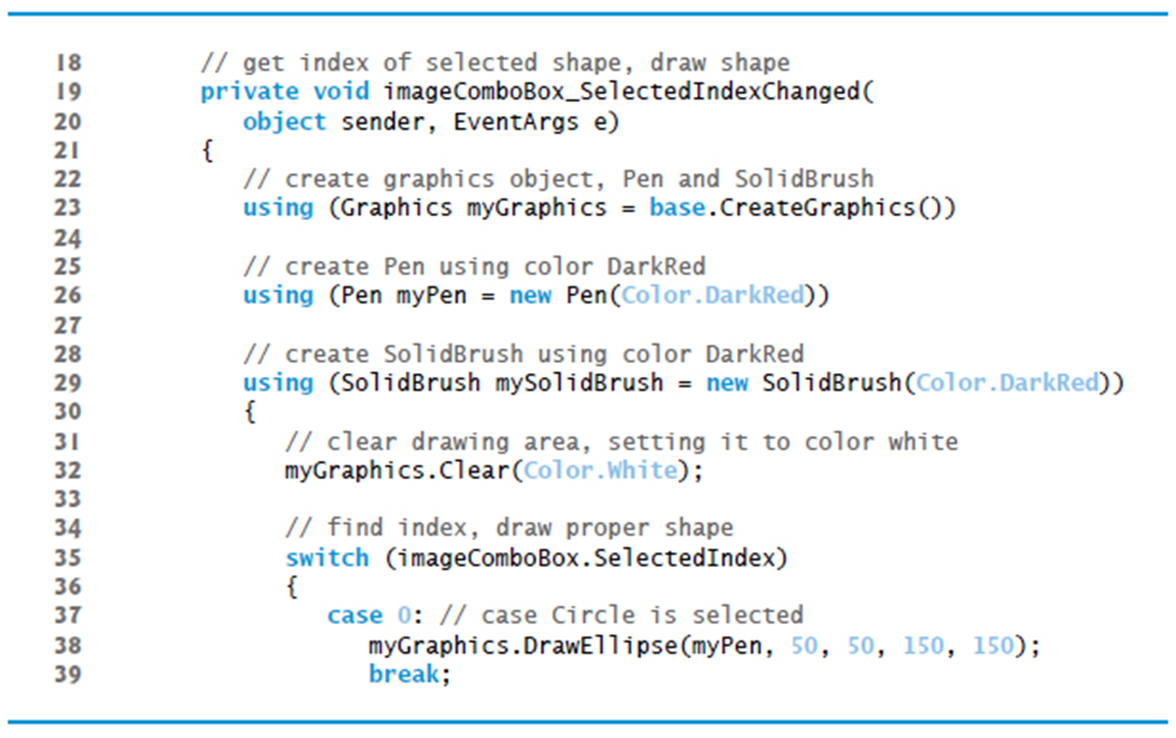
Figure 15.23 Using ComboBox to Select a Shape to Draw (2 of 5)

Slide 93
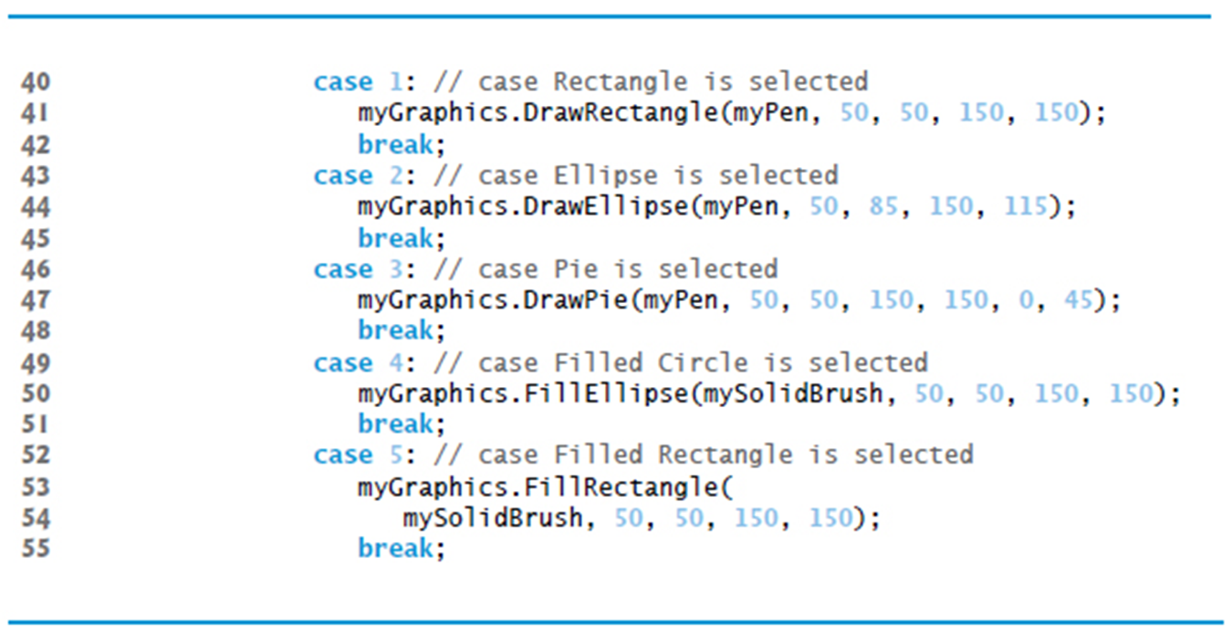
Figure 15.23 Using ComboBox to Select a Shape to Draw (3 of 5)

Slide 94
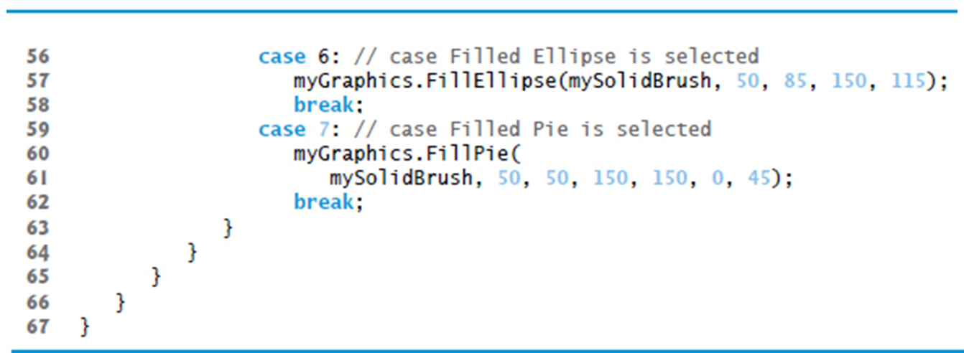
Figure 15.23 Using ComboBox to Select a Shape to Draw (4 of 5)

Slide 95
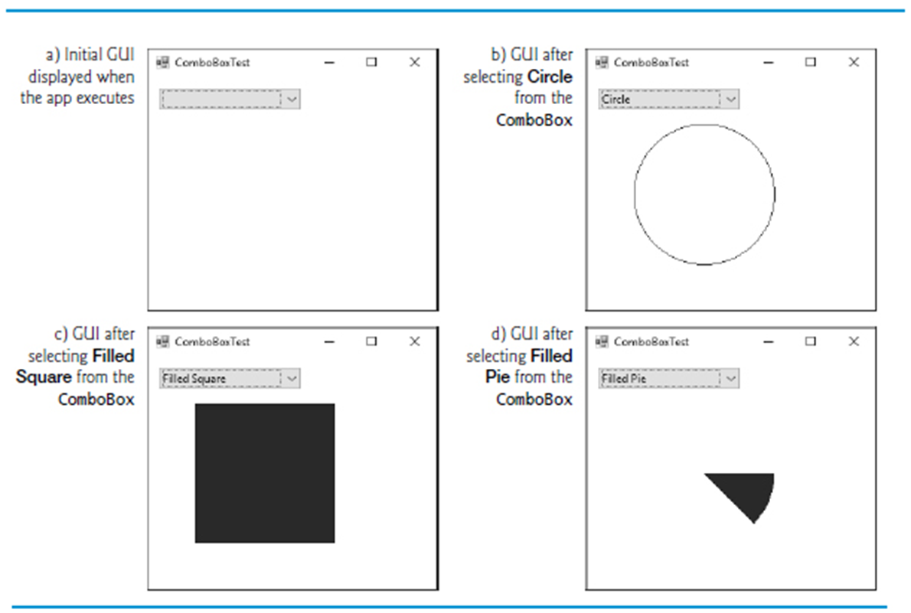
Figure 15.23 Using ComboBox to Select a Shape to Draw (5 of 5)

Slide 96
15.9 TreeView Control (1 of 2)
The TreeView control displays nodes hierarchically in a tree.
A parent node contains child nodes, and the child nodes can be parents to other nodes.
Two child nodes that have the same parent node are considered sibling nodes.
The first parent node of a tree is the root node (a TreeView can have multiple roots).

Slide 97
15.9 TreeView Control (2 of 2)
The nodes in a TreeView (Figure 15.24) are instances of class TreeNode.
Each TreeNode has a Nodes collection (type TreeNodeCollection), which contains a list of its children.

Slide 98
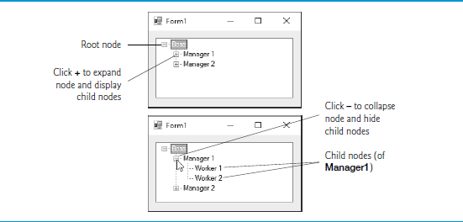
Figure 15.24 TreeView Displaying a Sample Tree

Slide 99
Figure 15.25 TreeView Properties and an Event (1 of 2)
Common Properties
TreeView properties and an event | Description
CheckBoxes | Indicates whether CheckBoxes appear next to nodes. A value of true displays CheckBoxes. The default value is false.
ImageList | Specifies an ImageList object containing the node icons. An ImageList object is a collection that contains Image objects.
Nodes | Returns the collection of TreeNodes in the control as a TreeNodeCollection. It contains methods Add (adds a TreeNode object), Clear (deletes the entire collection) and Remove (deletes a specific node). Removing a parent node deletes all of its children.
SelectedNode | The selected node.

Slide 100
Figure 15.25 TreeView Properties and an Event (2 of 2)
Common Event (Event arguments TreeViewEventArgs)
TreeView properties and an event | Description
AfterSelect | Generated after selected node changes. This is the default event when the control is double clicked in the designer.

Slide 101
Figure 15.26 TreeNode Properties and Methods (1 of 3)
Common Properties
TreeNode properties and methods | Description
Checked | Indicates whether the TreeNode is checked (CheckBoxes property must be set to true in the parent TreeView).
FirstNode | Specifies the first node in the Nodes collection (i.e., the first child in the tree).
FullPath | Indicates the path of the node, starting at the root of the tree.
ImageIndex | Specifies the index in the TreeView’s ImageList of the image shown when the node is deselected.
LastNode | Specifies the last node in the Nodes collection (i.e., the last child in the tree).
NextNode | Next sibling node.

Slide 102
Figure 15.26 TreeNode Properties and Methods (2 of 3)
TreeNode properties and methods | Description
Nodes | Collection of TreeNodes contained in the current node (i.e., all the children of the current node). It contains methods Add (adds a TreeNode object), Clear (deletes the entire collection) and Remove (deletes a specific node). Removing a parent node deletes all of its children.
PrevNode | Previous sibling node.
SelectedImageIndex | Specifies the index in the TreeView’s ImageList of the image to use when the node is selected.
Text | Specifies the TreeNode’s text.

Slide 103
Figure 15.26 TreeNode Properties and Methods (3 of 3)
Common Methods
TreeNode properties and methods | Description
Collapse | Collapses a node.
Expand | Expands a node.
ExpandAll | Expands all the children of a node.
GetNodeCount | Returns the number of child nodes.

Slide 104
15.9 TreeView Control (3 of 4)
To add nodes to the TreeView visually, click the ellipsis next to the Nodes property in the Properties window.
This opens the TreeNode Editor (Figure 15.27).

Slide 105
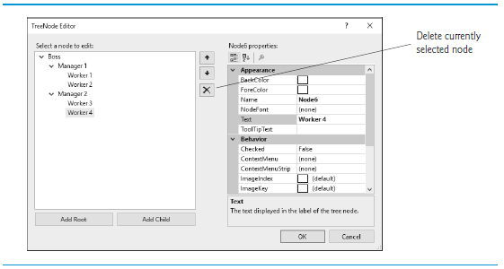
Figure 15.27 TreeNode Editor

Slide 106

15.9 TreeView Control (4 of 4)
To add nodes programmatically, first create a root node.
To add children to a root node first select the appropriate root node:
To add a child to the root node at index myIndex, write:
Class TreeViewDirectoryStructureForm (Figure 15.28) uses a TreeView to display the contents of a directory.

Slide 107
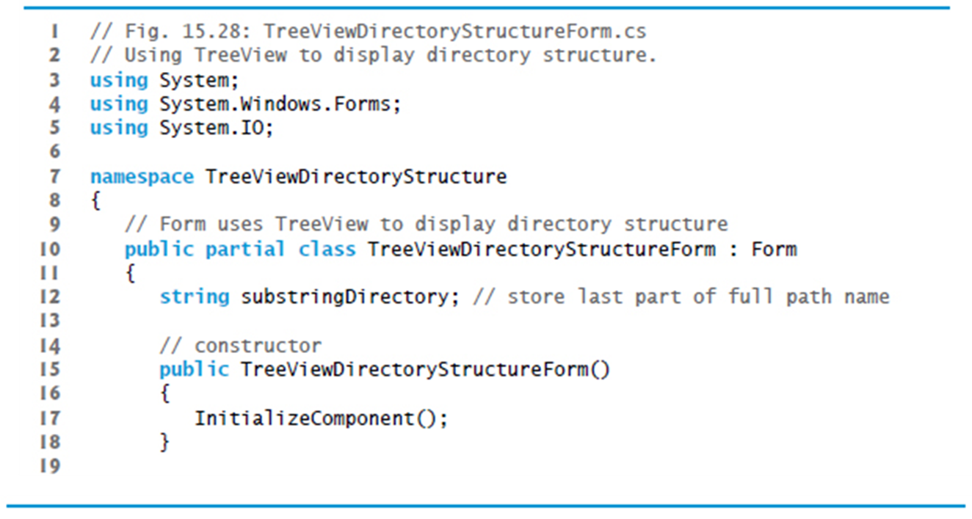
Figure 15.28 Using TreeView to Display Directory Structure (1 of 6)

Slide 108
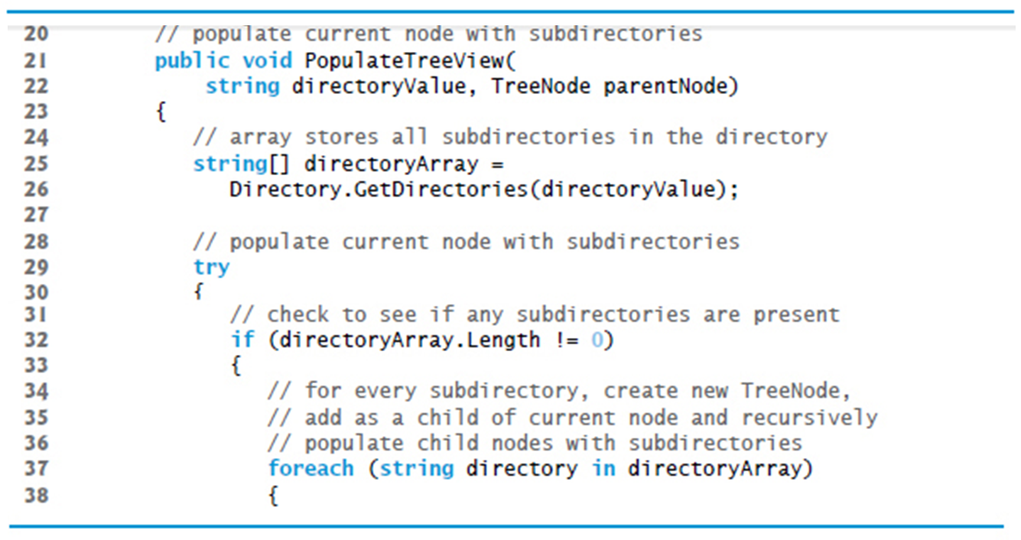
Figure 15.28 Using TreeView to Display Directory Structure (2 of 6)

Slide 109
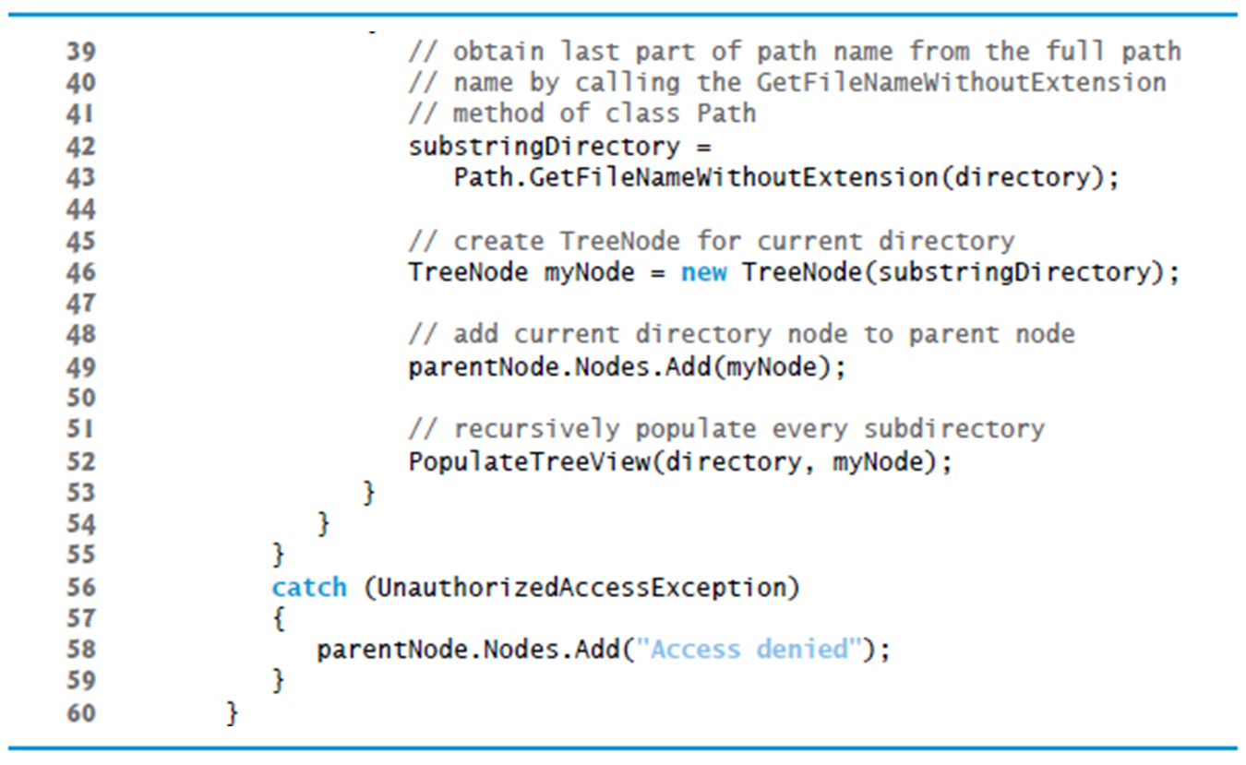
Figure 15.28 Using TreeView to Display Directory Structure (3 of 6)

Slide 110

Figure 15.28 Using TreeView to Display Directory Structure (4 of 6)

Slide 111

Figure 15.28 Using TreeView to Display Directory Structure (5 of 6)

Slide 112

Figure 15.28 Using TreeView to Display Directory Structure (6 of 6)

Slide 113
15.10 ListView Control (1 of 4)
The ListView control is more versatile than a ListBox and can display items in different formats.
For example, a ListView can display icons next to the list items and show the details of items in columns.
The details of these properties and the ItemActivate event are explained in Figure 15.29.

Slide 114
Figure 15.29 ListView Properties and Events (1 of 3)
Common Properties
ListView properties and events | Description
Activation | Determines how the user activates an item. This property takes a value in the ItemActivation enumeration. Possible values are OneClick (single-click activation), TwoClick (double-click activation, item changes color when the mouse moves over the item) and Standard (the default; double-click activation, item does not change color).
CheckBoxes | Indicates whether items appear with CheckBoxes. true displays CheckBoxes. The default is false.
LargeImageList | Specifies the ImageList containing large icons for display.
Items | Returns the collection of ListViewItems in the control.
MultiSelect | Determines whether multiple selection is allowed. The default is true, which enables multiple selection.

Slide 115
Figure 15.29 ListView Properties and Events (2 of 3)
ListView properties and events | Description
SelectedItems | Returns the collection of selected items as a ListView.SelectedListViewItemCollection.
SmallImageList | Specifies the ImageList containing small icons for display
View | Determines appearance of ListViewItems. Possible values are LargeIcon (the default; large icon displayed, items can be in multiple columns), SmallIcon (small icon displayed, items can be in multiple columns), List (small icons displayed, items appear in a single column), Details (like List, but multiple columns of information can be displayed per item) and Tile (large icons displayed, information provided to right of icon).

Slide 116
Figure 15.29 ListView Properties and Events (3 of 3)
Common Events
ListView properties and events | Description
Click | Generated when an item is clicked. This is the default event.
ItemActivate | Generated when an item in the ListView is activated (clicked or double clicked). Does not contain the specifics of which item is activated—you can use SelectedItems or SelectedIndices to determine this.

Slide 117
15.10 ListView Control (2 of 4)
ListView allows you to define the images used as icons for items.
Create a ListView, then select the Images property in the Properties window to display the Image Collection Editor (Figure 15.30).
Adding images this way embeds them into the app.

Slide 118

Figure 15.30 Images Collection Editor Window for an ImageList Component

Slide 119
15.10 ListView Control (3 of 4)
Set property SmallImageList of the ListView to the new ImageList object.
Property SmallImageList specifies the image list for the small icons.
Property LargeImageList sets the ImageList for large icons.
Class ListViewTestForm (Figure 15.31) displays files and folders in a ListView.
If a file or folder is inaccessible because of permission settings, a MessageBox appears.

Slide 120

Figure 15.31 Displaying Directories and Their Contents in a ListView (1 of 8)

Slide 121

Figure 15.31 Displaying Directories and Their Contents in a ListView (2 of 8)

Slide 122

Figure 15.31 Displaying Directories and Their Contents in a ListView (3 of 8)

Slide 123

Figure 15.31 Displaying Directories and Their Contents in a ListView (4 of 8)

Slide 124

Figure 15.31 Displaying Directories and Their Contents in a ListView (5 of 8)

Slide 125

Figure 15.31 Displaying Directories and Their Contents in a ListView (6 of 8)

Slide 126

Figure 15.31 Displaying Directories and Their Contents in a ListView (7 of 8)

Slide 127

Figure 15.31 Displaying Directories and Their Contents in a ListView (8 of 8)

Slide 128
15.10 ListView Control (4 of 4)
This program loads quickly, because it indexes only the files in the current directory.
As a result, a small delay may occur when a new directory is loaded.

Slide 129
Software Engineering Observation 15.2
When designing apps that run for long periods of time, you might choose a large initial delay to improve performance throughout the rest of the program. However, in apps that run for only short periods, developers often prefer fast initial loading times and small delays after each action.

Slide 130
15.11 TabControl Control (1 of 4)
The TabControl creates tabbed windows, such as those in Visual Studio (Figure 15.32)

Slide 131

Figure 15.32 Tabbed Windows in Visual Studio

Slide 132

15.11 TabControl Control (2 of 4)
TabControls contain TabPage objects, which are similar to Panels.
First add controls to the TabPage objects, then add the TabPages to the TabControl.
We can use method AddRange to add an array of TabPages or controls to a TabControl or TabPage.

Slide 133

Figure 15.33 TabControl with TabPages Example

Slide 134
15.11 TabControl Control (3 of 4)
Add TabControls visually by dragging and dropping them onto a Form in Design mode.
To add TabPages in Design mode, click the top of the TabControl, open its smart tasks menu and select Add Tab (Figure 15.34).
To select a TabPage, click the control area underneath the tabs.
Common properties and a common event of TabControls are described in Figure 15.35.

Slide 135

Figure 15.34 TabPages Added to a TabControl

Slide 136
Figure 15.35 TabControl Properties and an Event (1 of 2)
Common Properties
TabControl properties and an event | Description
ImageList | Specifies images to be displayed on tabs.
ItemSize | Specifies the tab size.
Multiline | Indicates whether multiple rows of tabs can be displayed.
SelectedIndex | Index of the selected TabPage.
SelectedTab | The selected TabPage.
TabCount | Returns the number of tab pages.
TabPages | Returns the collection of TabPages within the TabControl as a TabControl.TabPageCollection.

Slide 137
Figure 15.35 TabControl Properties and an Event (2 of 2)
Common Event
TabControl properties and an event | Description
SelectedIndexChanged | Generated when SelectedIndex changes (i.e., another TabPage is selected).

Slide 138
15.11 TabControl Control (4 of 4)
Class UsingTabsForm (Figure 15.36) uses a TabControl to display various options relating to the text on a label (Color, Size and Message).

Slide 139

Figure 15.36 Using TabControl to Display Various Font Settings (1 of 6)

Slide 140

Figure 15.36 Using TabControl to Display Various Font Settings (2 of 6)

Slide 141

Figure 15.36 Using TabControl to Display Various Font Settings (3 of 6)

Slide 142

Figure 15.36 Using TabControl to Display Various Font Settings (4 of 6)

Slide 143

Figure 15.36 Using TabControl to Display Various Font Settings (5 of 6)

Slide 144

Figure 15.36 Using TabControl to Display Various Font Settings (6 of 6)

Slide 145
Software Engineering Observation 15.3
A TabPage can act as a container for a single logical group of RadioButtons, enforcing their mutual exclusivity. To place multiple RadioButton groups inside a single TabPage, you should group RadioButtons within Panels or GroupBoxes contained within the TabPage.

Slide 146
15.12 Multiple Document Interface (M D I) Windows (1 of 6)
Many complex apps are multiple document interface (M D I) programs, which allow users to edit multiple documents at once.
An M D I program’s main window is called the parent window, and each window inside the app is referred to as a child window.
Figure 15.37 depicts a sample M D I app with two child windows.
To create an M D I Form, create a new Form and set its IsMdiContainer property to true (Figure 15.38).

Slide 147

Figure 15.37 M D I Parent Window and M D I Child Windows

Slide 148

Figure 15.38 S D I and M D I Forms

Slide 149

15.12 Multiple Document Interface (M D I) Windows (2 of 6)
Right click the project in the Solution Explorer, select Project → Add Windows Form… and name the file.
Set the Form’s MdiParent property to the parent Form and call the child Form’s Show method.
In most cases, the parent Form creates the child, so the parentForm reference is this.

Slide 150
Figure 15.39 M D I Parents and M D I Child Properties, a Method and an Event (1 of 2)
Common M D I Child Properties
M D I Form properties, a method and an Event | Description
IsMdiChild | Indicates whether the Form is an M D I child. If true, Form is an M D I child (read-only property).
MdiParent | Specifies the M D I parent Form of the child.
Common M D I Parent Properties
M D I Form properties, a method and an Event | Description
ActiveMdiChild | Returns the Form that’s the currently active M D I child (returns null if no children are active).
sMdiContainer | Indicates whether a Form can be an M D I parent. If true, the Form can be an M D I parent. The default value is false.
MdiChildren | Returns the M D I children as an array of Forms.

Slide 151
Figure 15.39 M D I Parents and M D I Child Properties, a Method and an Event (2 of 2)
Common Method
M D I Form properties, a method and an Event | Description
LayoutMdi | Determines the display of child forms on an M D I parent. The method takes as a parameter an M d i Layout enumeration with possible values ArrangeIcons, Cascade, TileHorizontal and TileVertical. Figure 15.42 depicts the effects of these values.
Common Event
M D I Form properties, a method and an Event | Description
MdiChildActivate | Generated when an M D I child is closed or activated.

Slide 152
15.12 Multiple Document Interface (M D I) Windows (3 of 6)
Figure 15.40 shows two images: one containing two minimized child windows and a second containing a maximized child window.

Slide 153

Figure 15.40 Minimized and Maximized Child Windows

Slide 154
15.12 Multiple Document Interface (M D I) Windows (4 of 6)
Property MdiWindowListItem of class MenuStrip specifies which menu, if any, displays a list of open child windows.
When a new child window is opened, an entry is added to the end of the list (Figure 15.41).

Slide 155
Good Programming Practice 15.1
In an M D I app, include a menu that displays a list of the open child windows. This helps the user select a child window quickly.

Slide 156
15.12 Multiple Document Interface (M D I) Windows (5 of 6)
M D I containers allow you to organize the placement of its child windows.
Method LayoutMdi takes a value of the MdiLayout enumeration (Figure 15.42).
Class UsingM D IForm (Figure 15.43) demonstrates M D I windows.

Slide 157

Figure 15.41 MenuStrip Property MdiWindowListItem Example

Slide 158

Figure 15.42 MdiLayout Enumeration Values

Slide 159

Figure 15.43 Demonstrating use of M D I Parent and M D I Child Windows (1 of 6)

Slide 160

Figure 15.43 Demonstrating use of M D I Parent and M D I Child Windows (2 of 6)

Slide 161

Figure 15.43 Demonstrating use of M D I Parent and M D I Child Windows (3 of 6)

Slide 162

Figure 15.43 Demonstrating use of M D I Parent and M D I Child Windows (4 of 6)

Slide 163

Figure 15.43 Demonstrating use of M D I Parent and M D I Child Windows (5 of 6)

Slide 164

Figure 15.43 Demonstrating use of M D I Parent and M D I Child Windows (6 of 6)

Slide 165
15.12 Multiple Document Interface (M D I) Windows (6 of 6)
Define the M D I child class by right clicking the project in the Solution Explorer and selecting Add → Windows Form….
Name the new class ChildForm (Figure 15.44).

Slide 166

Figure 15.44 Child Window of M D I Parent

Slide 167
15.13 Visual Inheritance (1 of 4)
Visual inheritance enables you to achieve visual consistency.
For example, you could define a base Form that contains a product’s logo and a specific background color.
You then could use the base Form throughout an app for uniformity and branding.

Slide 168
15.13 Visual Inheritance (2 of 4)
Class VisualInheritanceBaseForm (Figure 15.45) derives from Form.
We use the public class VisualInheritanceBaseForm.
Use the namespace declaration that was created for us by the I D E.
Right click the project name in the Solution­ Explorer and select Properties, then choose the Application tab.
In the Output type drop-down list, change Windows Application to Class Library.
Building the project produces the .dll.

Slide 169

Figure 15.45 Base Form for Use with Visual Inheritance (1 of 2)

Slide 170

Figure 15.45 Base Form for Use with Visual Inheritance (2 of 2)

Slide 171

15.13 Visual Inheritance (3 of 4)
To visually inherit from VisualInheritanceBaseForm, create a new Windows Forms app.
In this app, add a reference to the .dll you just created.
Modify the line that defines the class:

Slide 172
15.13 Visual Inheritance (4 of 4)
In Design view, the new app’s Form should now display the controls inherited from the base Form (Figure 15.46).
Class VisualInheritanceTestForm (Figure 15.47) is a derived class of VisualInheritanceBaseForm.

Slide 173

Figure 15.46 Using the Reference Manager Dialog to Browse for a D L L (1 of 2)

Slide 174

Figure 15.46 Using the Reference Manager Dialog to Browse for a D L L (2 of 2)

Slide 175

Figure 15.47 Form Demonstrating Visual Inheritance

Slide 176

Figure 15.48 Derived Form Using Visual Inheritance (1 of 3)

Slide 177

Figure 15.48 Derived Form Using Visual Inheritance (2 of 3)

Slide 178

Figure 15.48 Derived Form Using Visual Inheritance (3 of 3)

Slide 179
15.14 User-Defined Controls (1 of 5)
The .NET Framework allows you to create custom controls.
Custom controls appear in the user’s Toolbox.
There are multiple ways to create a custom control, depending on the level of customization that you want (Figure 15.49).

Slide 180
Figure 15.49 Custom-Control Creation (1 of 2)
Custom-Control Techniques
Custom-control techniques and PaintEventArgs Properties | Description
Inherit from a Windows Forms control | You can do this to add functionality to a preexisting control. If you override method OnPaint, call the base class’s OnPaint method. You only can add to the original control’s appearance, not redesign it.
Create a UserControl | You can create a UserControl composed of multiple preexisting controls (example, to combine their functionality). You place drawing code in a Paint event handler or overridden OnPaint method.
Inherit from class Control | Define a brand new control. Override method OnPaint, then call base-class method OnPaint and add the code to draw the control. With this method you can customize both control appearance and functionality.

Slide 181
Figure 15.49 Custom-Control Creation (2 of 2)
PaintEventArgs Properties
Custom-control techniques and PaintEventArgs Properties | Description
Graphics | The control’s graphics object, which is used to draw on the control.
ClipRectangle | Specifies the rectangle indicating the boundary of the control.

Slide 182
15.14 User-Defined Controls (2 of 5)
Timers are non-visual components that generate Tick events at a set interval.
The Timer’s Interval property defines the number of milliseconds between events.
Create a UserControl class for the project by selecting Project → Add User Control ….
We name the file (and the class) ClockUserControl.
Add a Label and a Timer to the UserControl.
Set the Timer interval to 1000 milliseconds.
clockTimer must be enabled by setting Enabled to true.

Slide 183
15.14 User-Defined Controls (3 of 5)
Figure 15.50 shows the output of Clock, which contains our ClockUserControl.

Slide 184

Figure 15.50 User-Defined Control with a Timer and a Label (1 of 2)

Slide 185

Figure 15.50 User-Defined Control with a Timer and a Label (2 of 2)

Slide 186
15.14 User-Defined Controls (4 of 5)
To create a UserControl that can be exported to other solutions, do the following:
Create a new Class Library project.
Delete Class1.cs, initially provided with the app.
Right click the project in the Solution Explorer and select Add → User Control…
Add controls and functionality to the UserControl (Figure 15.51).
Build the project. Visual Studio creates a .dll file for the UserControl in the output directory (bin/Release or bin/Release).

Slide 187

Figure 15.51 Custom-Control Creation

Slide 188
15.14 User-Defined Controls (5 of 5)
Create a new Windows app.
Right click the ToolBox and select Choose Items….
In the Choose Toolbox Items dialog, click Browse…
Select the .dll file that you created.
The item will then appear in the Choose Toolbox Items dialog.
Check this item and click OK to add the item to the Toolbox.

Slide 189

Copyright

